Slide 1

Wed. Week 5
Upcoming:
By Mon. read: M. Butterfly, Hwang [NOT the Broadway revival edition]
Read: first paper topics under course documents
By Wed. read: “For the First Time, the Real-Life Models for Broadway’s M. Butterfly Tell of their Very Strange Romance,” Wadler
To think about for section this week:
In “Empires of my Mind,” Shaw intends to celebrate his local Chinese restaurant. But is his story also cringeworthy?
Does his story reflect Heldke’s “food colonialism” (395)?

Slide 2
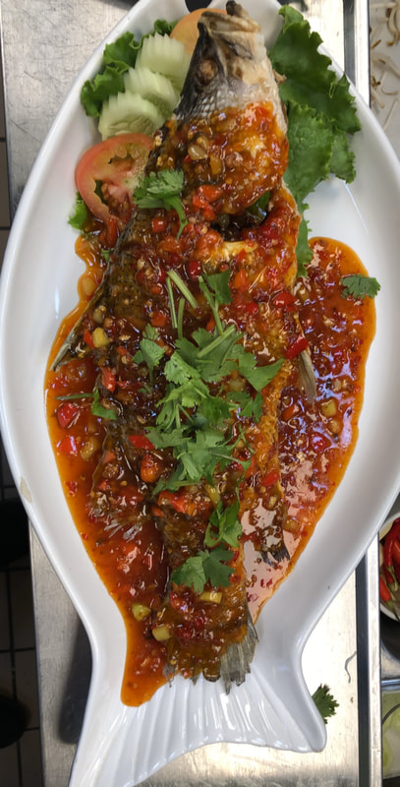
From “Let’s Eat Thai,” Heldke, p. 395
“I had come to see my adventure cooking and eating as strongly motivated by an attitude bearing deep connections to Western colonialism and imperialism . . . .
the attitude of various nineteenth-and twentieth-century European painters, anthropologists, and explorers who set out in search of ever ‘newer,’ every more ‘remote’ cultures they could co-opt, borrow from freely and out of context, and use as the raw material for their own efforts at creation and discovery.”

Slide 3
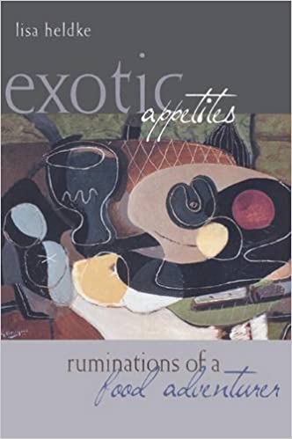
“If I can make Indonesian dishes that other food adventurers can only eat in restaurants, I become a kind of exotic myself” (Heldke, 398)

Slide 4
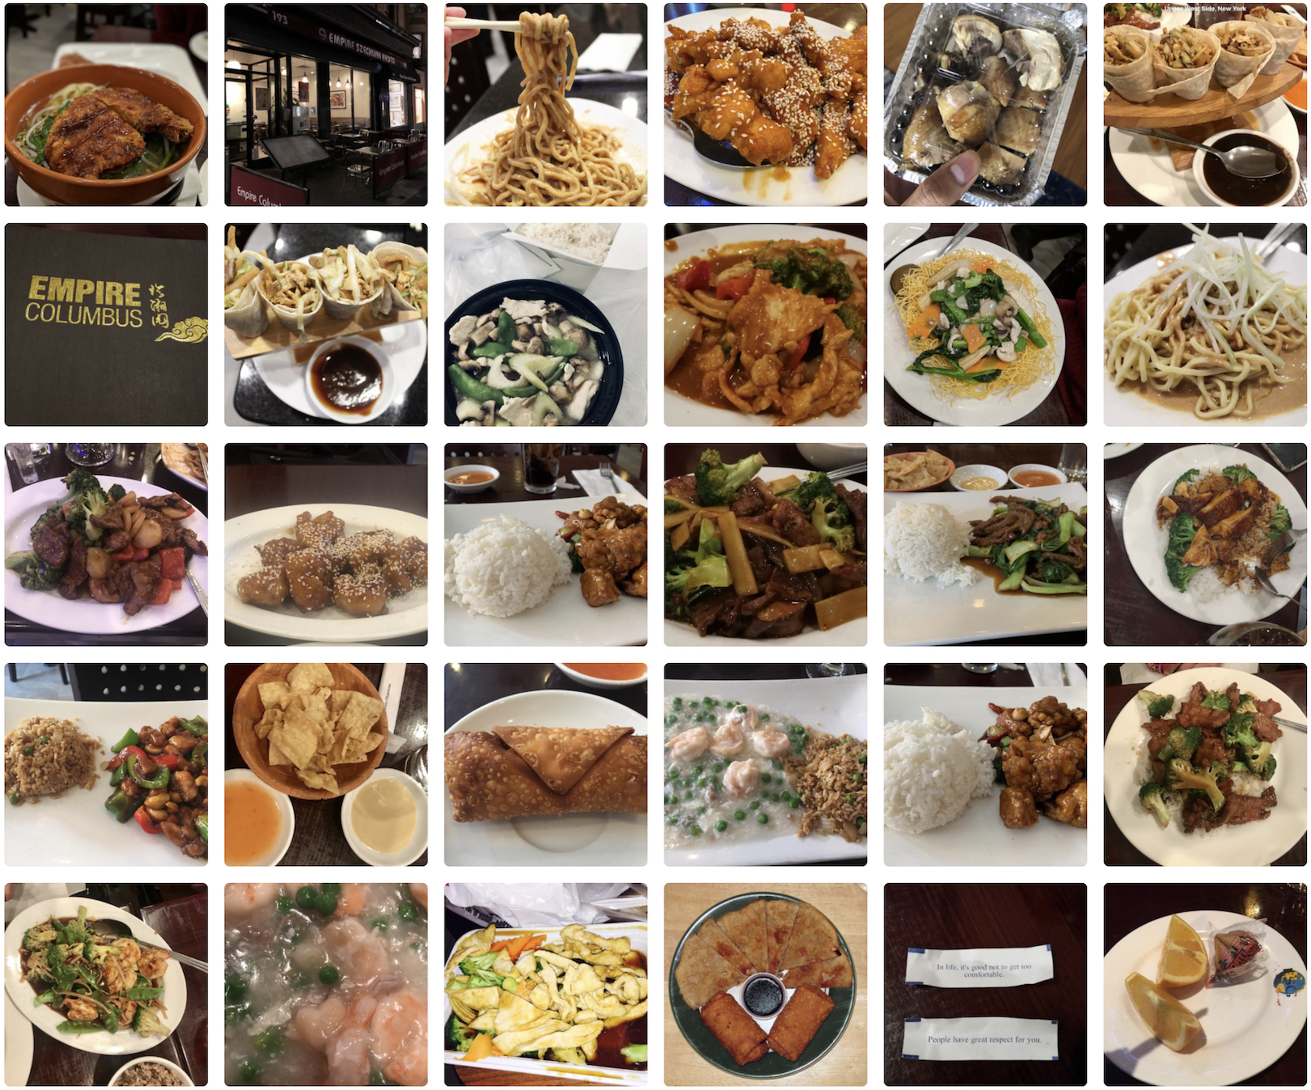
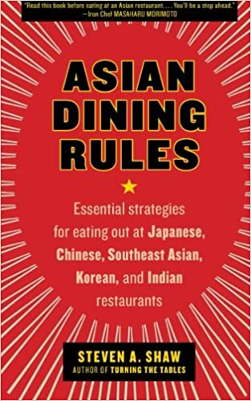
“Empires of My Mind: My Love Affair with Asian Food Begins,” SHAW
Shaw celebrates his neighborhood Chinese restaurant and conveys his close relationship with the people who run it.
What’s wrong with the picture he paints?

Slide 5

Question for our critical thinking on
“cuisine based multiculturalism”:
Does the broader acceptance of a people’s foodways necessarily translate into valuing a people?
Does it lead to greater acceptance, appreciation, or awareness?

Slide 6
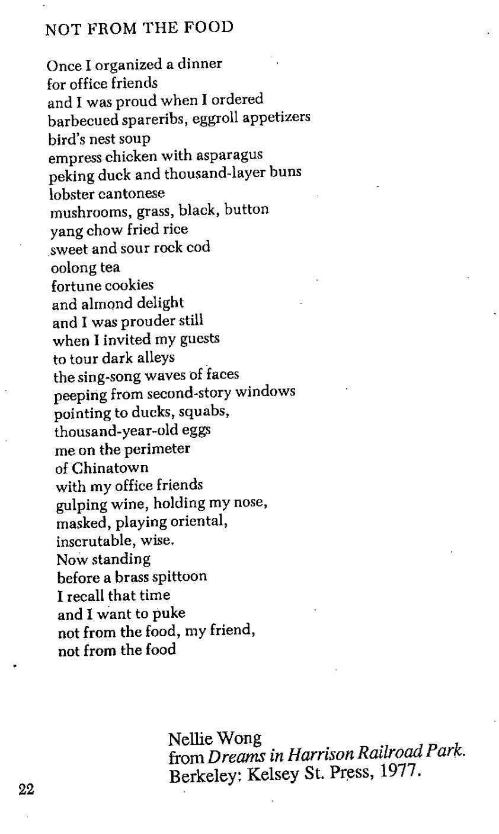
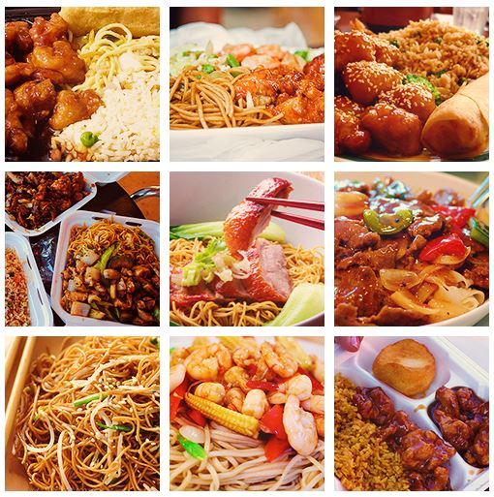

Slide 7
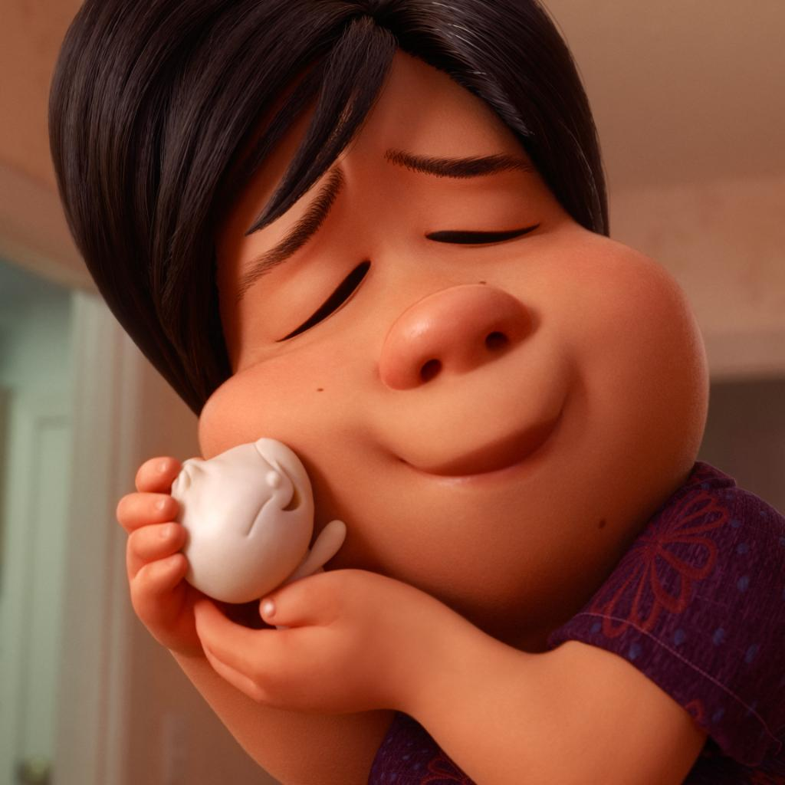
Bao, Shi

Slide 8
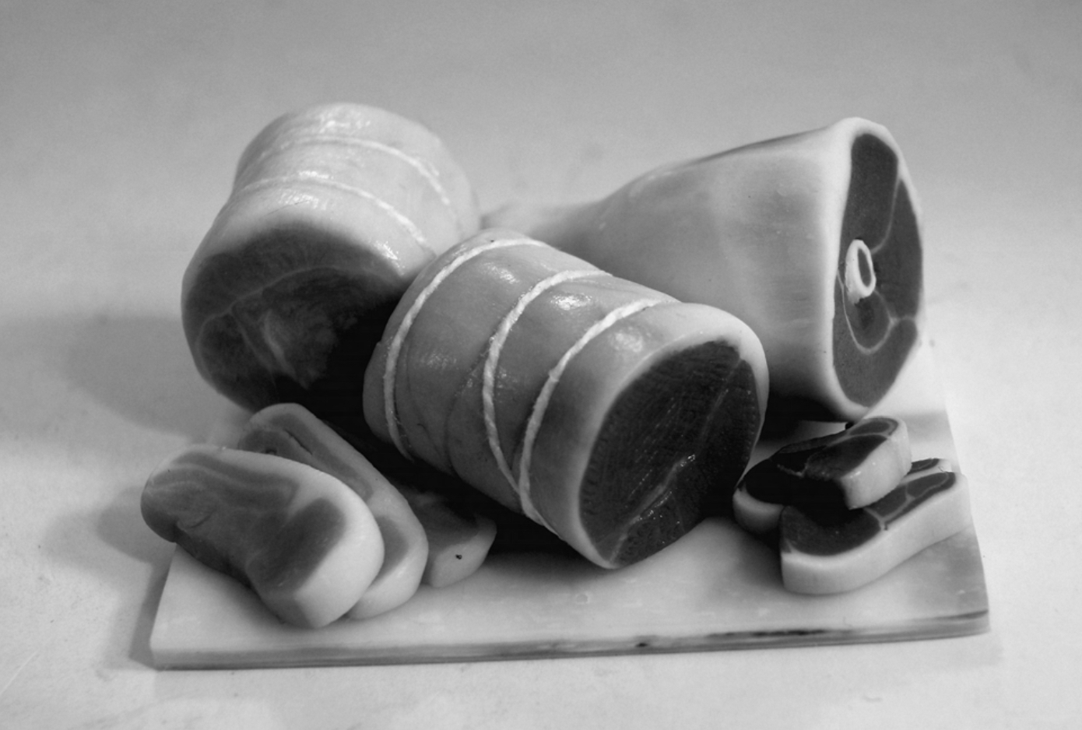
“Of course, I loved steak.
I loved steak even though I had never actually tried it” (60).
“Beefeaters,” Sekhon

